Slide 1
Variation of MSE with α and α² in Elastic-net Regression

Slide 2
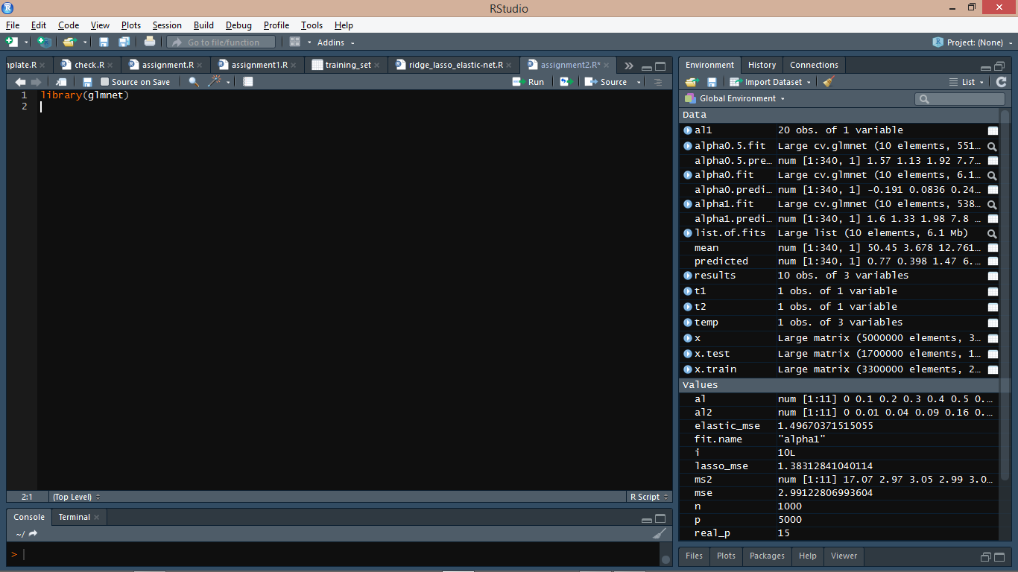
Notes:
We include the package Glmnet that fits a generalized linear model via penalized maximum likelihood.

Slide 3
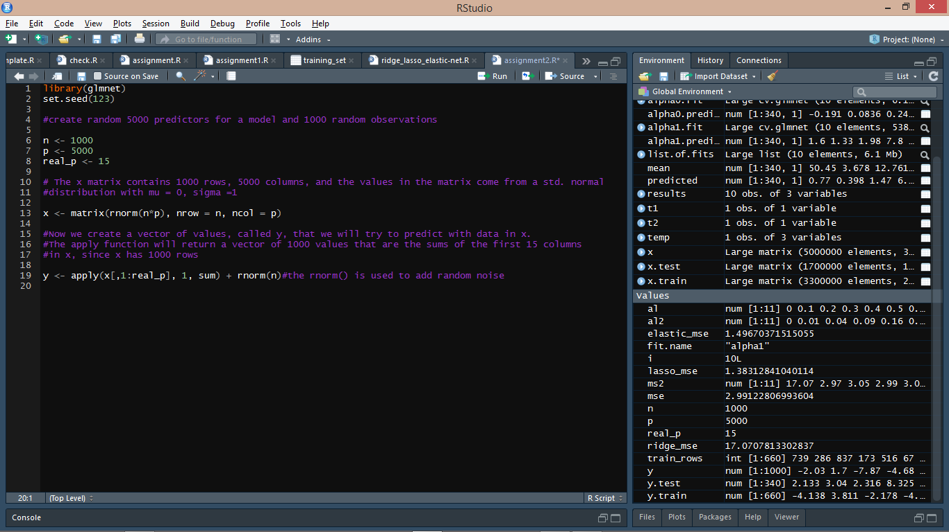
Notes:
We set the seed for the reproduction of the same dataset. Now, we create 5000 random predictors and 1000 random observations by creating a matrix in which the values come from a standard normal distribution with μ = 0 and σ = 1.
Now, we create a vector of values y, which is dependent on the first 15 columns of x and some random noise.

Slide 4
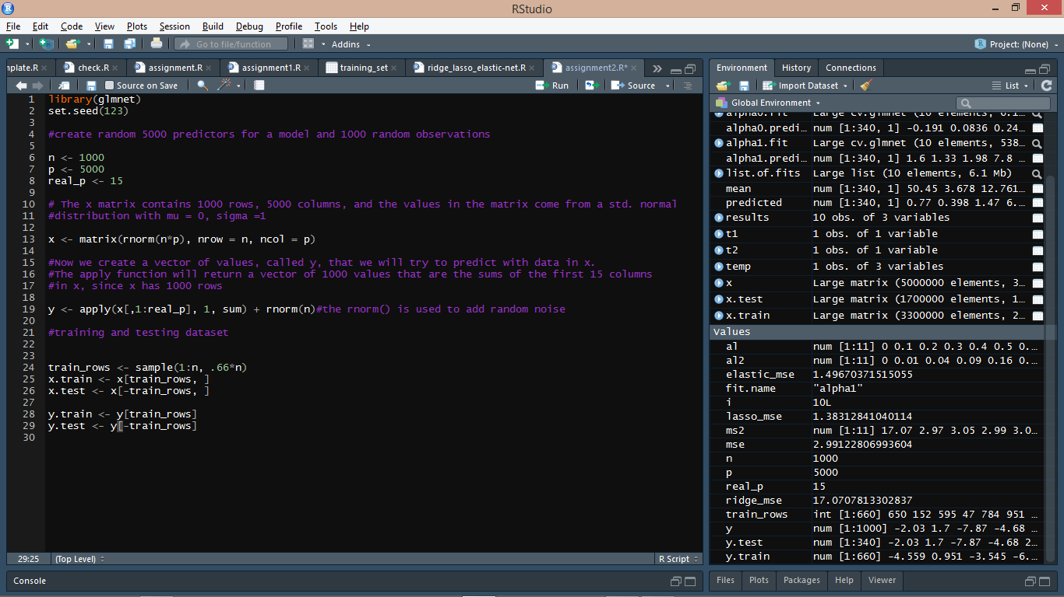
Notes:
We now divide the dataset into training dataset and testing dataset.

Slide 5
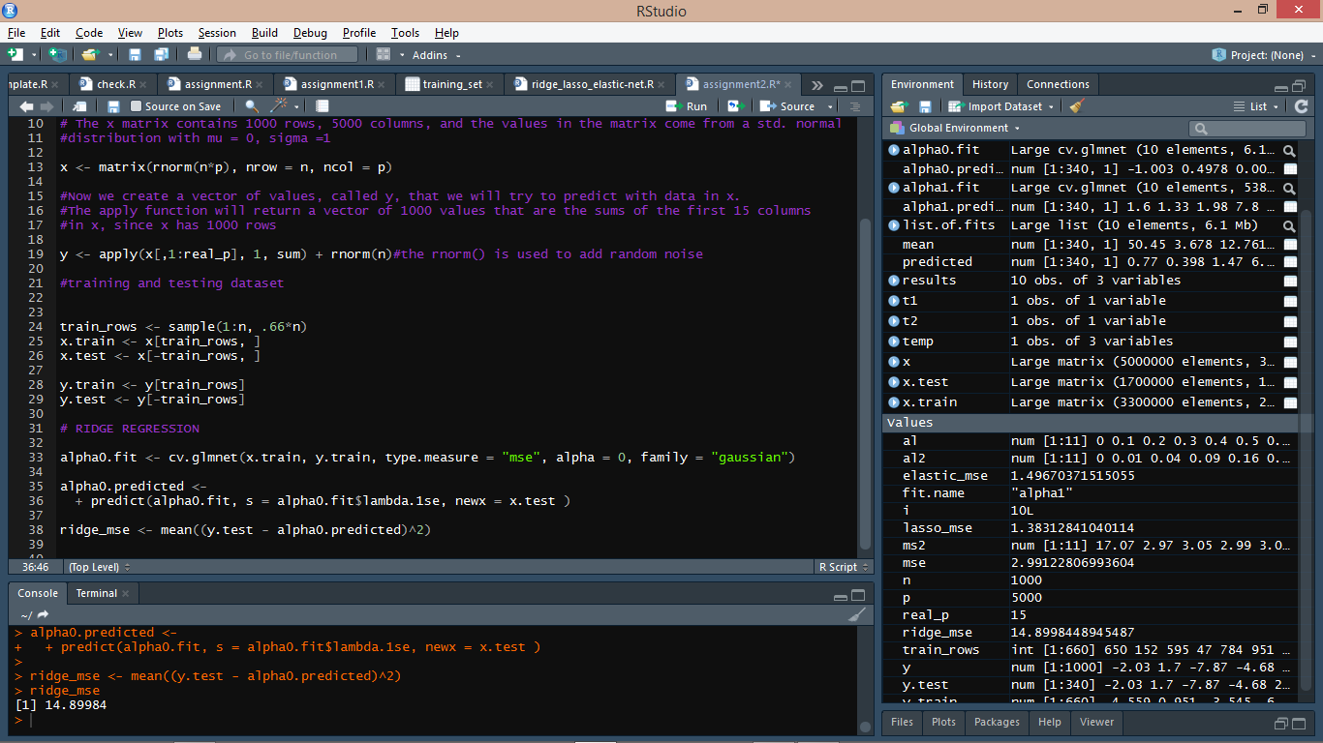
Notes:
We now apply ridge regression to x.train to predict y.train using c.glmnet function, which uses 10-fold cross validation. We set alpha = 0 in the case of ridge regression. The MSE in this case comes out to be : 14.89984.

Slide 6
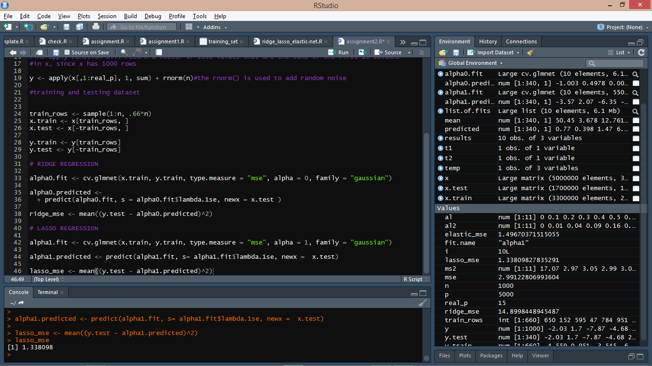
Notes:
We now apply lasso regression using the same function. Except in this case, we set alpha = 1. The MSE in this case comes out to be : 1.338098

Slide 7
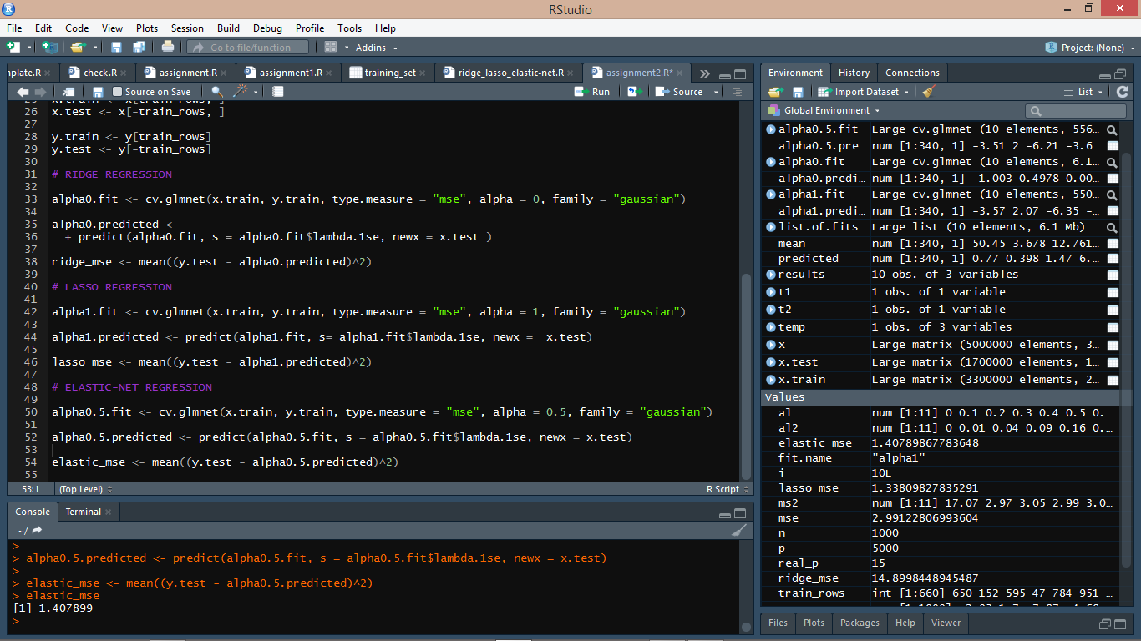
Notes:
We now apply elastic-net regression using the same function. Except in this case, we set alpha = 0.5. The MSE in this case comes out to be : 1.407899

Slide 8
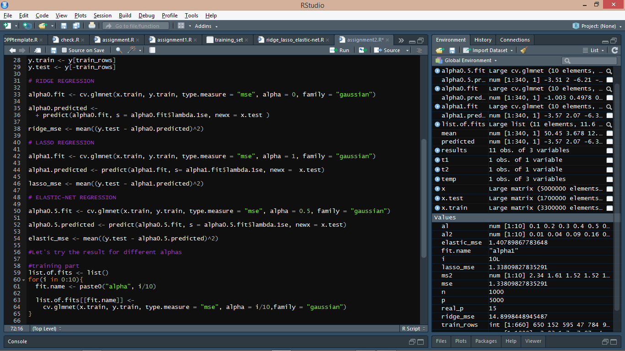
Notes:
Now, we will check the values of MSE for different values of alpha. This is the training part.

Slide 9
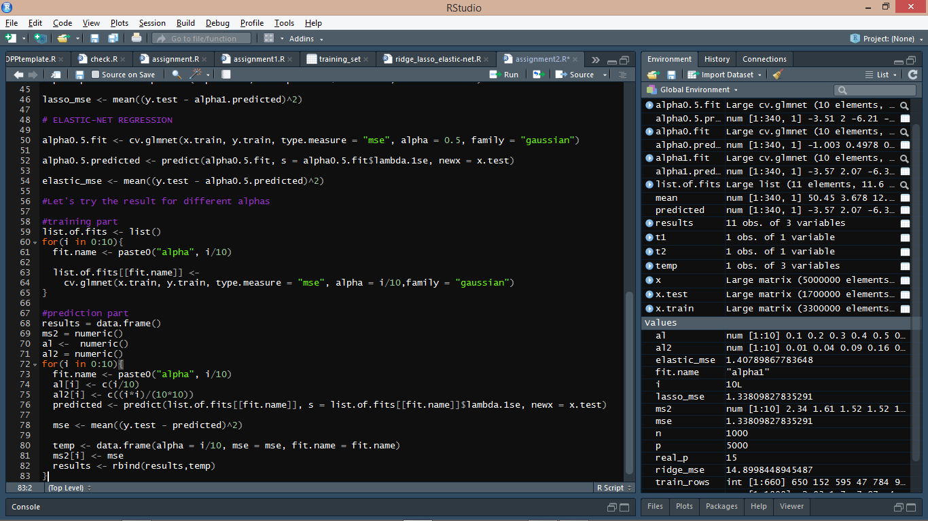
Notes:
This is the prediction part of our model. We store the results in a dataframe. We create 3 variables – ms2, al and al. ms2 stores the values of each MSE, al stores the different values of α, and al2 stores the different values of α².

Slide 10
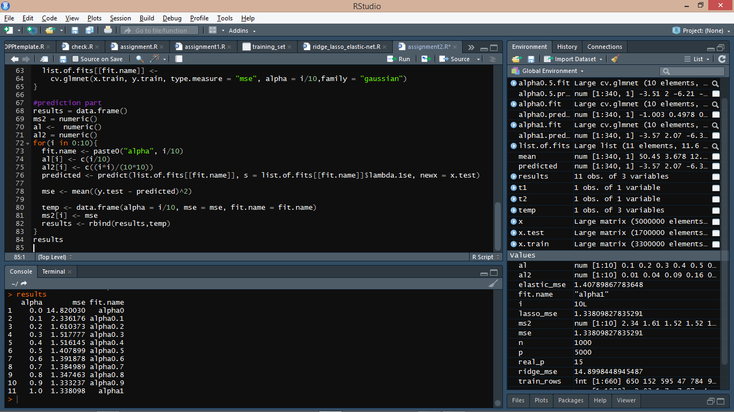
Notes:
The results are displayed above.

Slide 11
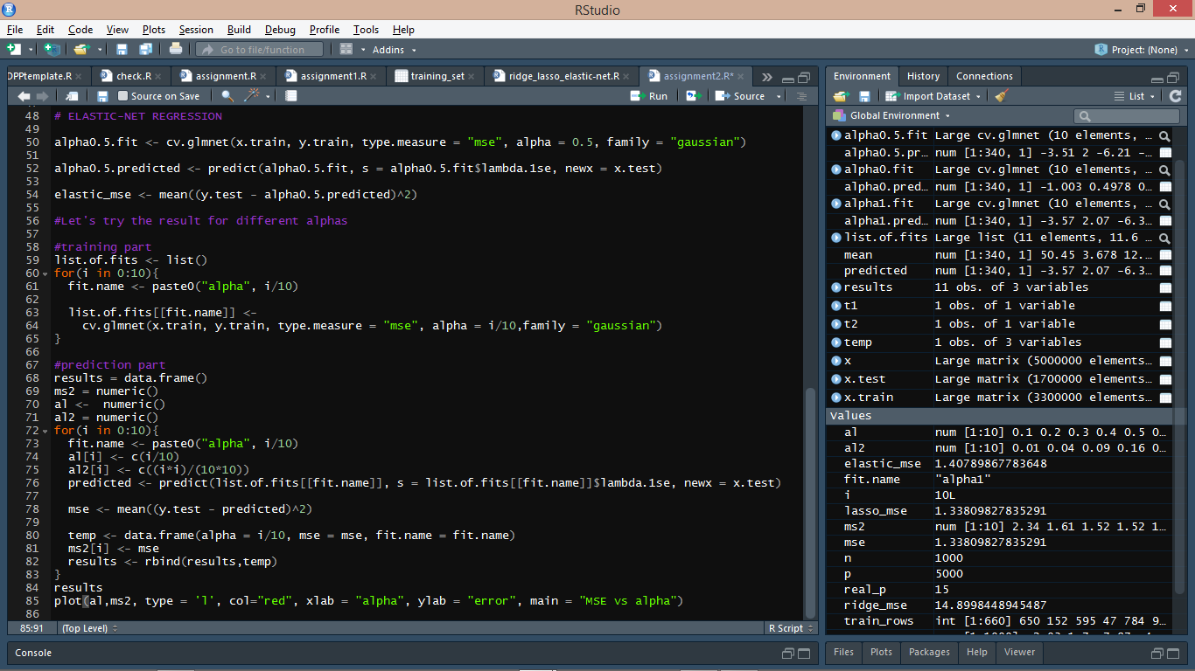
Notes:
The plot between MSE and α is shown on the next slide.

Slide 12
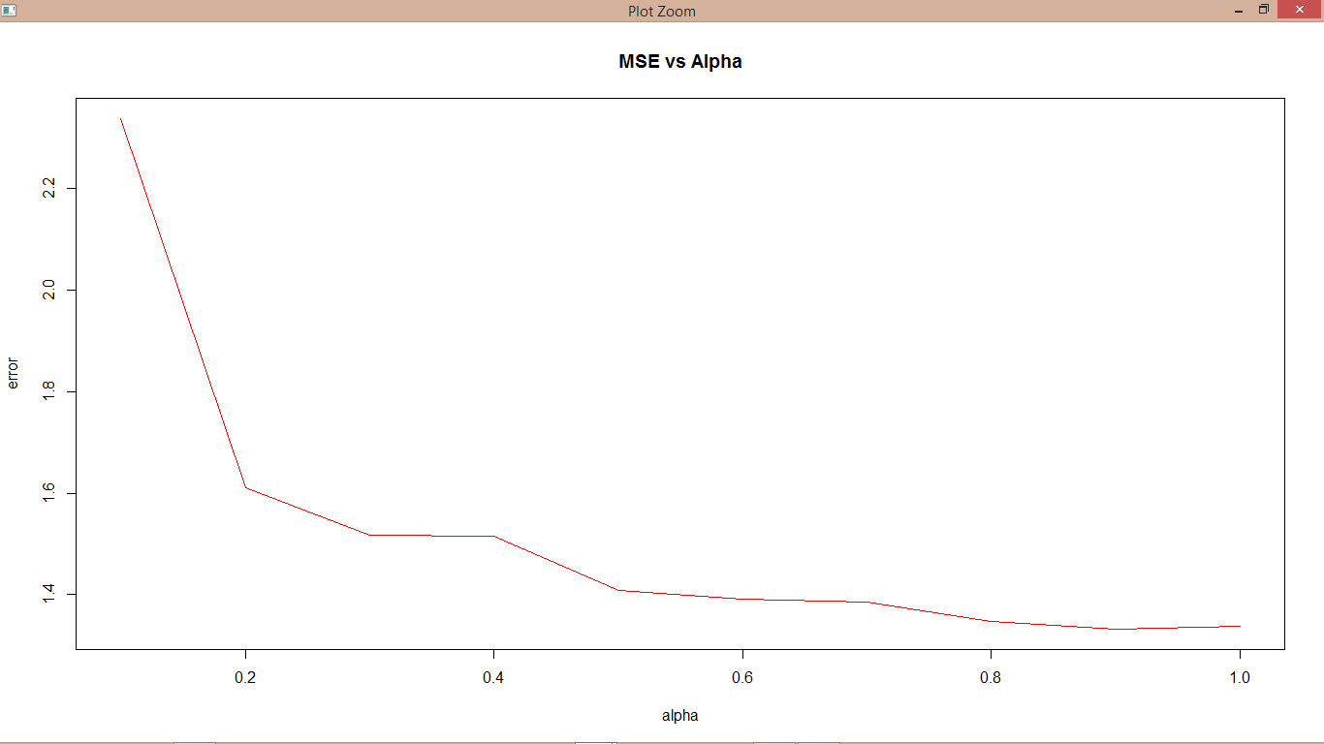
Notes:
Error vs alpha plot.

Slide 13
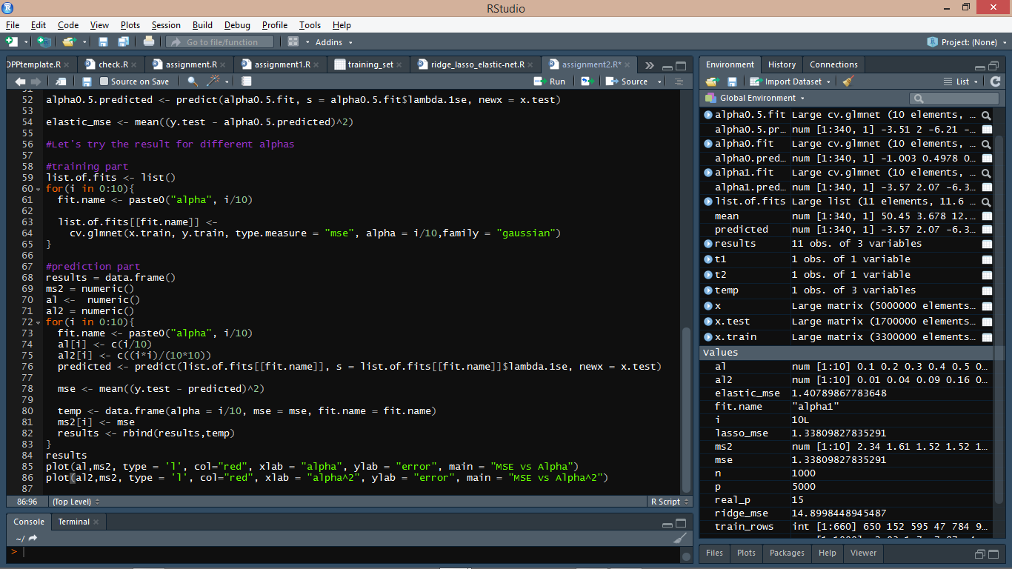
Notes:
The MSE vs α² plot is shown on the next slide.

Slide 14
